Slide 1

Integrated Compound Profiling and Biological Evaluation of Garden Snail Mucus
Presented by Sidra sajjad

Slide 2
Background
Multiple research students at the university are working under the umbrella of Prime Snail Mucus
Each student is assigned a distinct research focus on snail mucus
Key research areas include:
Biological activities
Chemical and compound profiling
Biomedical applications
Cosmetic and industrial potential
Collectively, these projects provide a comprehensive scientific understanding of snail mucus

Slide 3
Snail Mucus Research According to Student Projects
According to ongoing student research, snail mucus is a biologically active natural secretion
Student studies demonstrate diverse biological activities.
Compound and chemical profiling reveal the presence of bioactive constituents.
Research highlights strong potential in biomedical applications
Findings also support the cosmetic and industrial value of snail mucus
Collectively, student projects contribute to a comprehensive scientific understanding of snail mucus

Slide 4
Methodology
Mucus Extrction
Chemical methods
Compound Extraction
Chemical and Compound profiling
Biological Activities
Gas Chromatography–Mass Spectrometry
Antioxidative activity:
DppH
Total antioxidant capacity (Phosphomolybdenum method
Reducing Power
Cytoxicity Test:
Brime shrimp
Hemolytic assay
Anti microbial:
Anti-bacterial (well diffusion)
MI,MBC
Anti-fungal (well diffusion)
Data Analysis

Slide 5
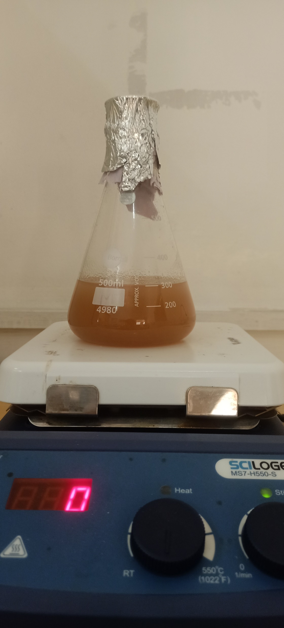
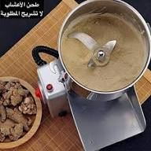
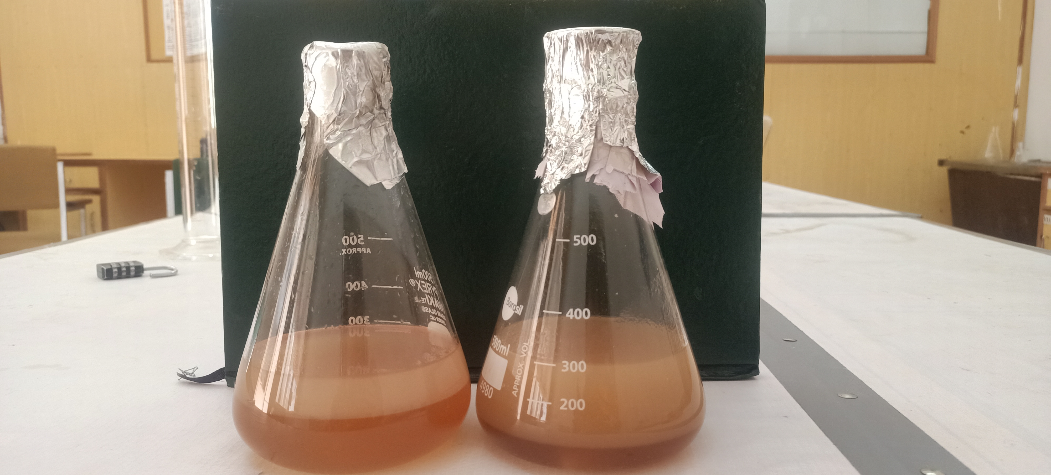
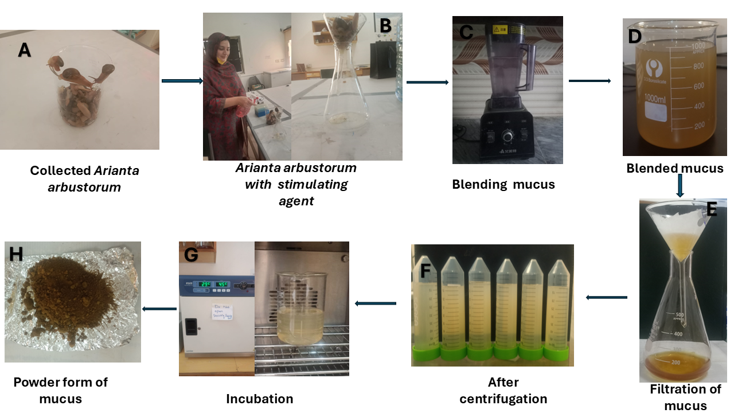
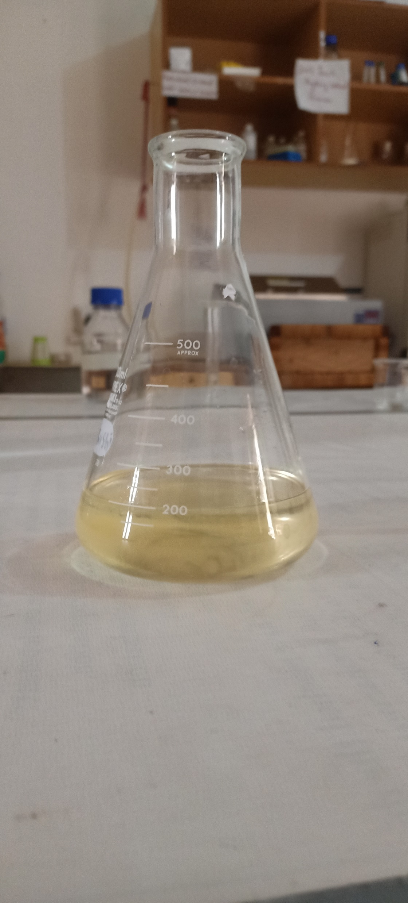
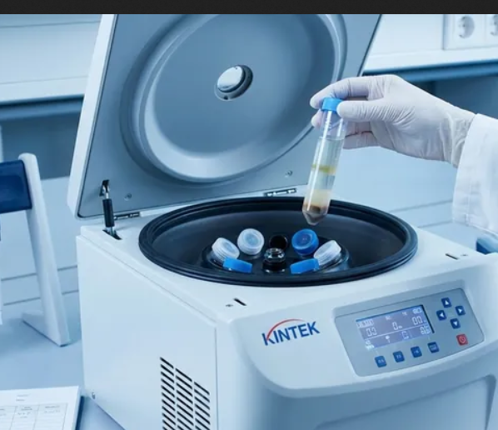
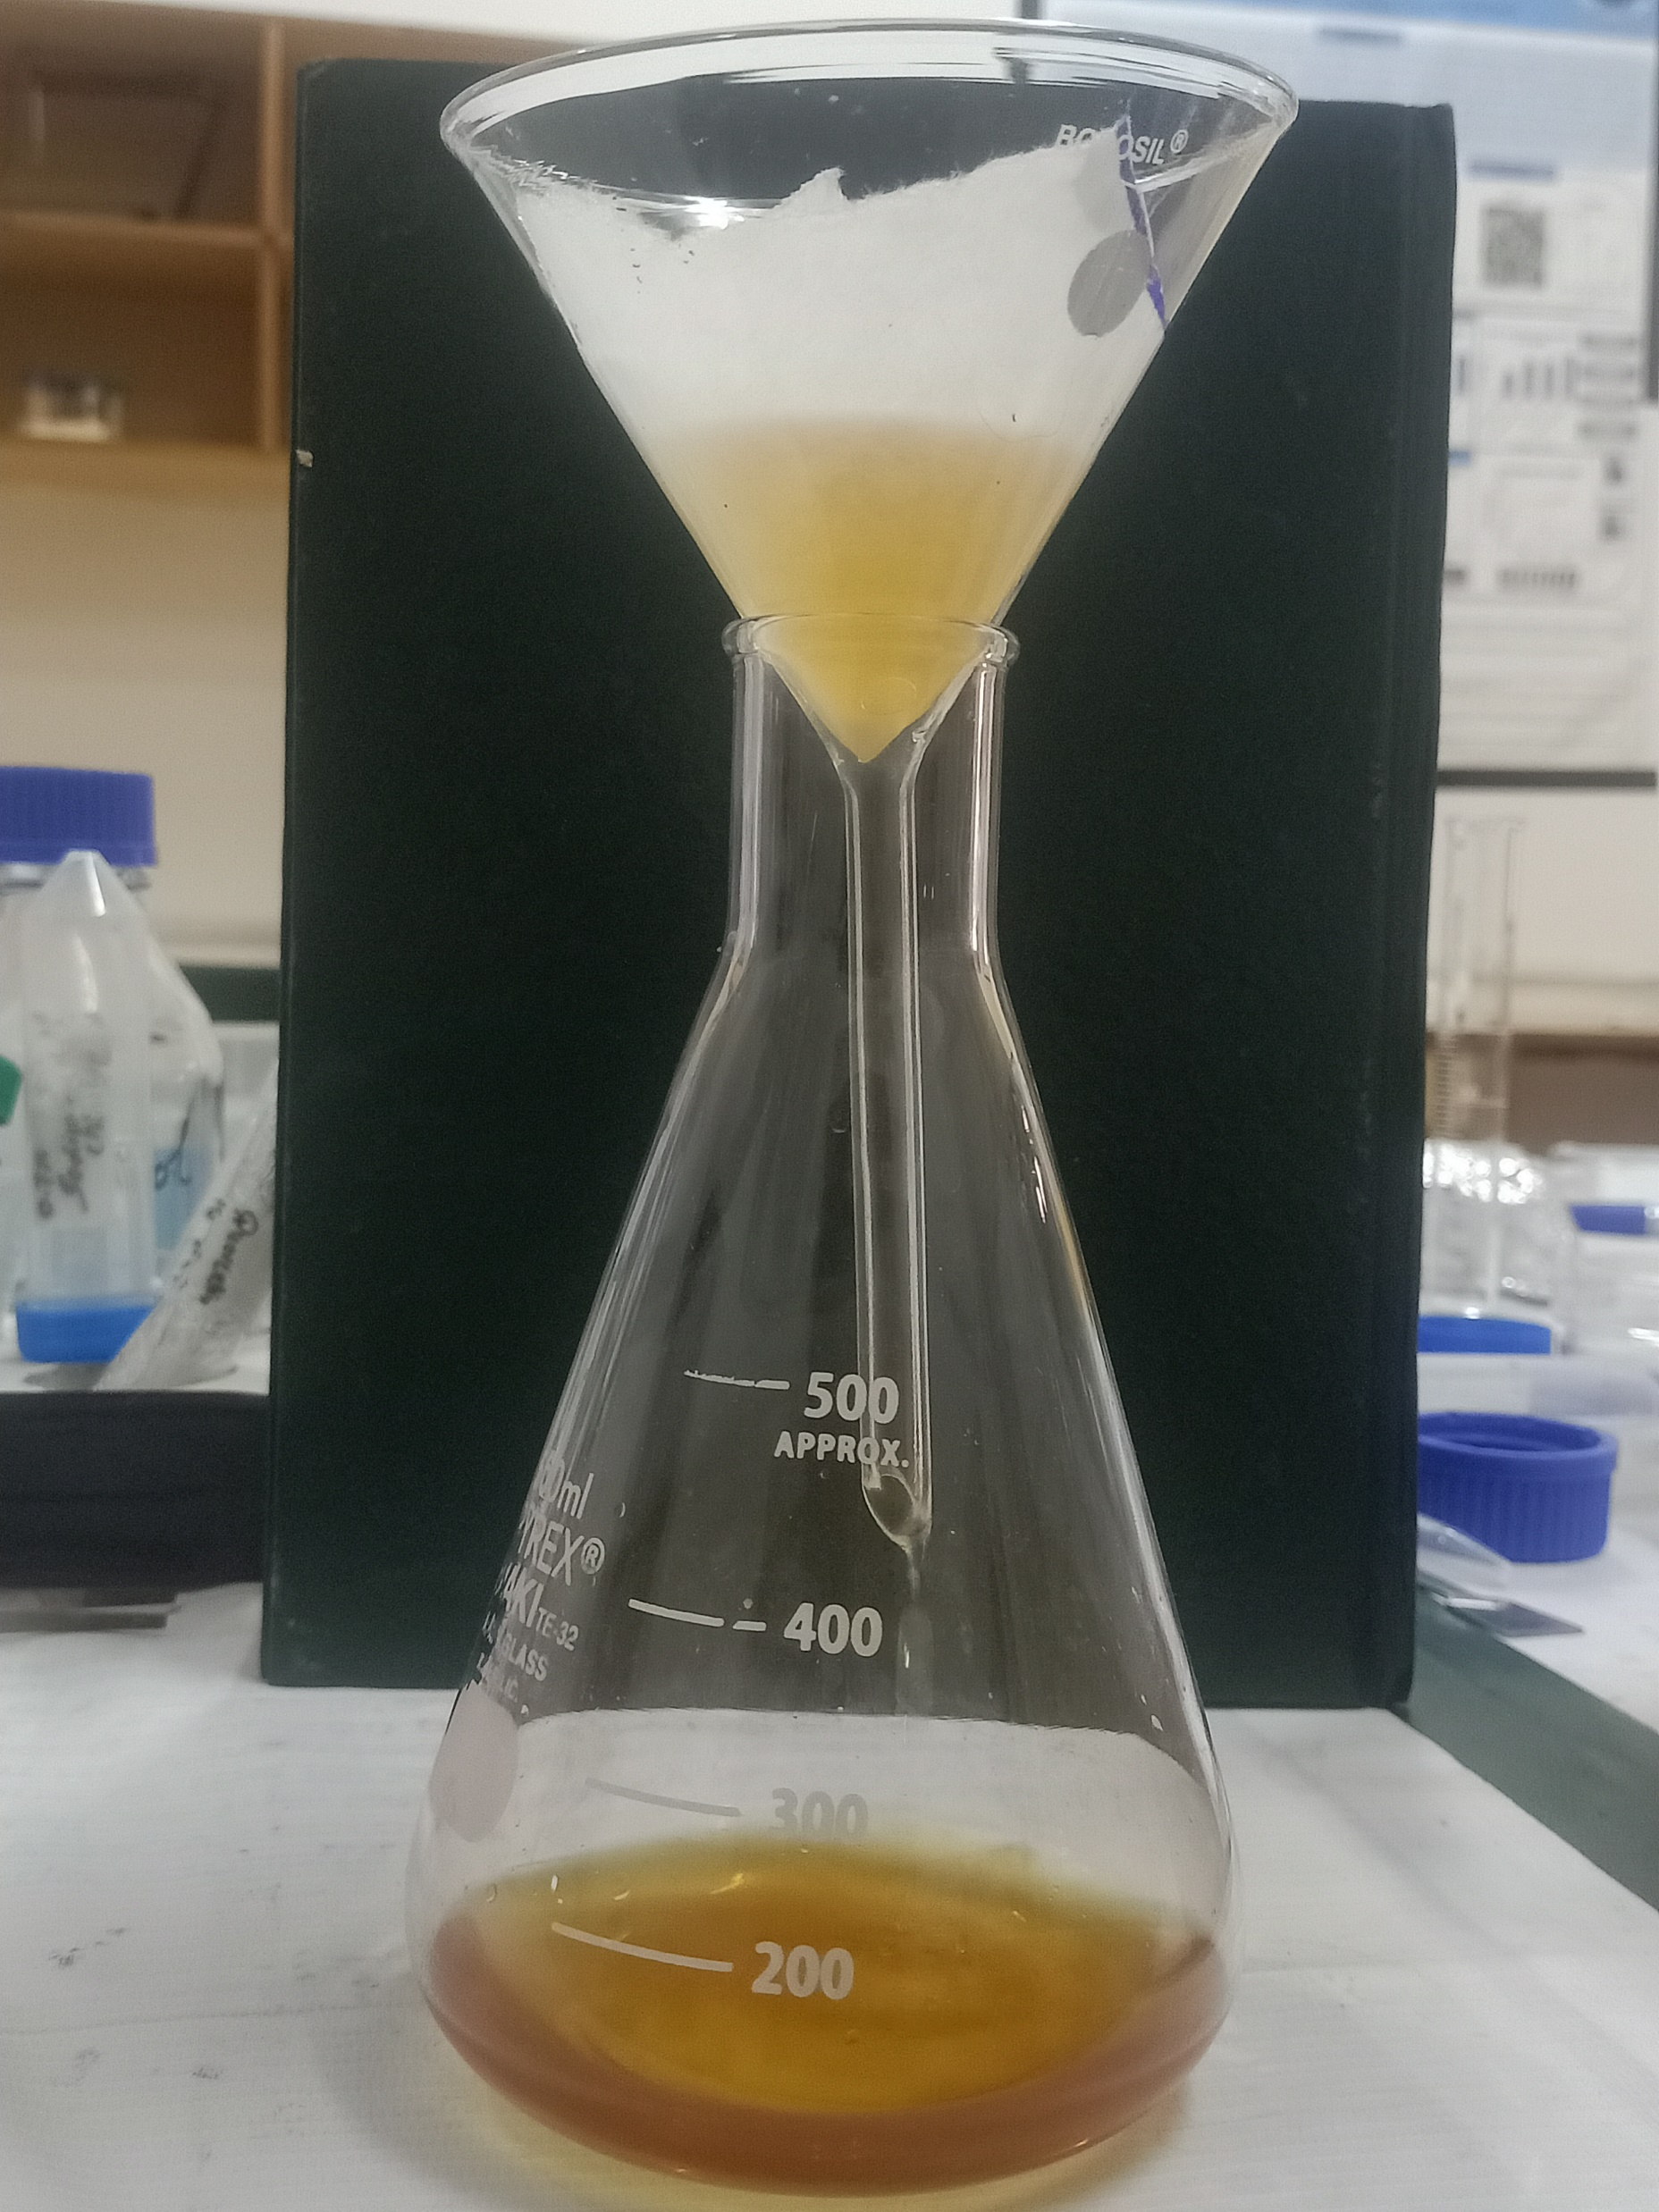
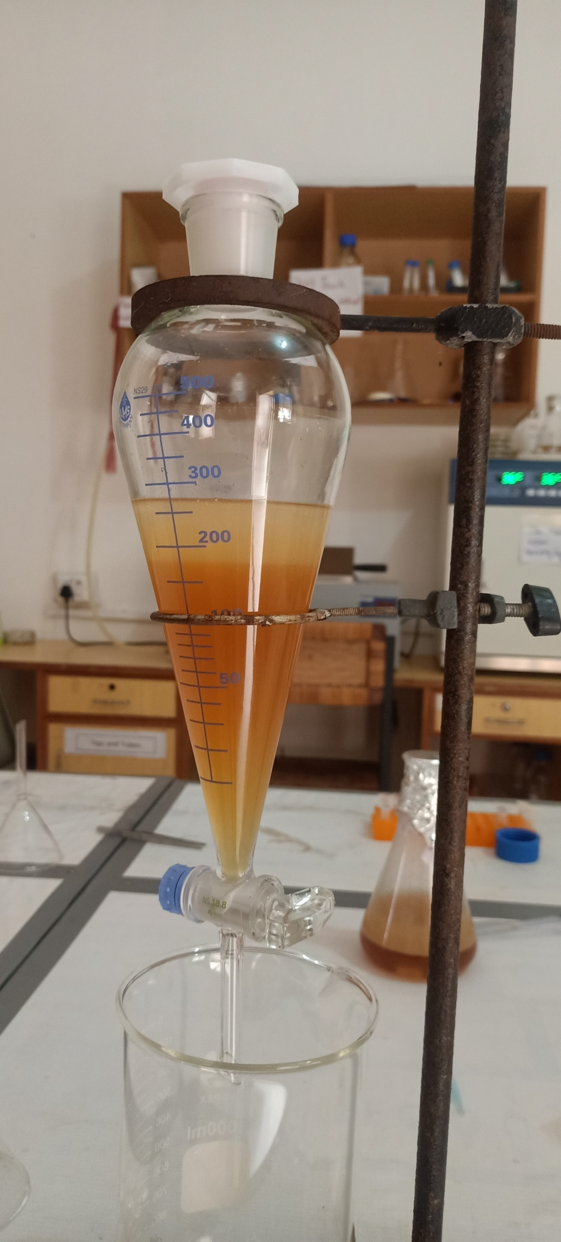
Finding….
B
C
D
Collected snails
Mucus by chemical method
Grinding mucus Gel
Mucus-solvent mixture
H
G
F
E
Separating the friction
Purified Extracted mucus
Centrifugation
Filtration
Figure 1 representing the complete flow work of sample collection and mucus extraction and purification (A) representing the snail collected for farm of prime snail mucus (B)representing the mucus form snail (C) representing the mucus gel grinding (D) representing the mucus and solvent mixture (E) separating the mucus and solvent mixture (E) filtration of the mucus (G) representing the centrifugation of the mucus (H) purified

Slide 6
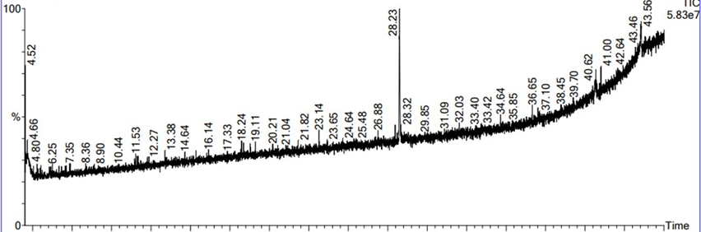
Gas Chromatography–Mass Spectrometry
S.N o | Retention time (min) | Compounds | Molecular formula | Molecular weight (g/mol) | Peak area %
1 | 4.518 | 1,1'- (Ethanediylidenediam ino)bis(5-amino-1H- tetrazole | C4H6N12 | 222.18 | 0.552
2 | 4.548 | Deoxyspergualin | C17H37N7 O3 | 387.5 | 0.552
3 | 4.658 | Dec-9-en-6-oxo-1- ylamide | C10H17NO 2 | 183.247 | 9.714
4 | 28.239 | 5-Fluorotryptophan | C11H11FN2 O2 | 222.22 | 2.921
5 | 38.144 | Benzenemethanol, 4- [(1- ethylpropyl)amino]-2- methyl-3,5-dinitro- | C13H19N3 O5 | 297.31 | 0.267
6 | 40.355 | Carnegine | C13H19NO 2 | 221.29 | 0.340
7 | 40.65 | 1H- Cyclopenta[a]cyclopr opa[e]cyclodecen-11- one,5,6-bis(acetyloxy)- 4-[(acetyloxy)methyl]- 5a-hydroxy-1,1,7,9- tetramethyl- octahydro, [1aR- (1aα,2α,5α,5aα,6α,8aα ,9α,10aα) | C26H34O8 | 474.5 | 0.436
8 | 43.551 | Calein C | C22H28O8 | 420.5 | 1.113
9 | 44.377 | Hexanal, (2,4- dinitrophenyl)hydraz one | C12H16N4 O4 | 280.28 | 0.311
Figure 2 GC-MS chromatogram of volatile compounds in Snail mucus . Retention Time (X-axis) vs. % Peak Area (Y-axis).
Table 1.Retention time, molecular formula, molecular weight, and peak area of volatile compounds detected in methanolic extract snail mucus

Slide 7
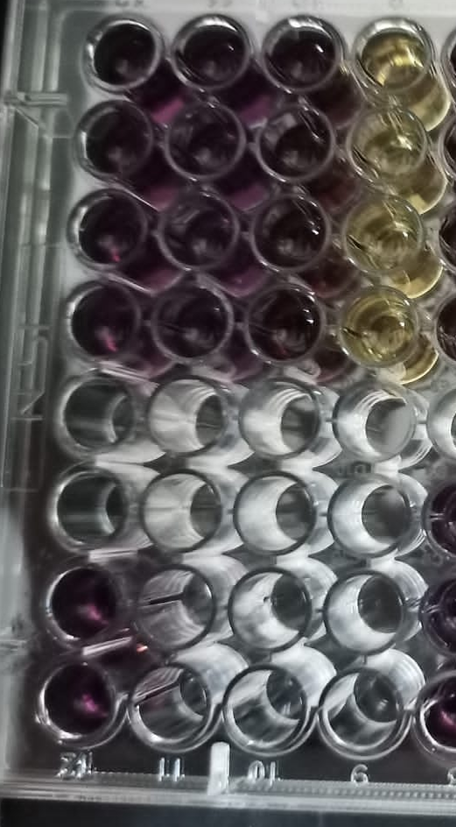
Biological Activity- Antioxidative Activity
DPPH:
N
s1
s2
C
Figure 4 DPPH free radical scavenging activity of snail mucus at different concentrations. The graph shows a concentration-dependent increase in antioxidant activity, with % scavenging rising from ~52% at 5 µg/mL to ~56.8% at 20 µg/mL. The linear regression line (y = 0.3026x + 0.122, R² = 0.9234) indicates a strong positive correlation between concentration and DPPH scavenging.
Figure 3 represents the 96-well plate

Slide 8
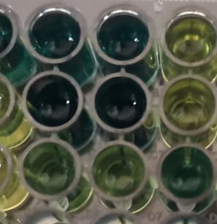
Biological Activity- Antioxidative Activity
Total Reducing Power :
N
s1
s2
C
Figure 5 represents the 96-well plate
Figure 6 Total Reducing Power of snail mucus. The figure represents the electron-donating ability of the sample, indicating its antioxidant potential.

Slide 9
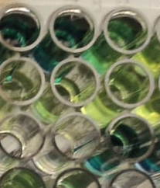
Biological Activity- Antioxidative Activity
Total Antioxidant capacity :
N
S1
C
Figure 7 represents the 96-well plate
Figure 8 TAC of snail mucus. The figure represents the electron-donating ability of the sample, indicating its antioxidant potential.).

Slide 10
Biological Activity-Cytotoxicity Activity
Brine shrimp's assay:
SOLVENT | Concentration | Total no. of Brine Shrimps | Live Brine shrimp | Dead Brine shrimp | % of Dead Brine Shrimps
Snail mucus | 10 ppm | 10 | 6 | 4 | 40%
 | 50ppm | 10 | 4 | 6 | 60%
 | 500ppm | 10 | 2 | 8 | 80%
 | Control media | 10 | 10 | 0 | 0%
Table 2. Represent the total no of brine shrimp, live shrimp, and % dead shrimp
Figure 9 Brine shrimp assay of snail mucus.

Slide 11
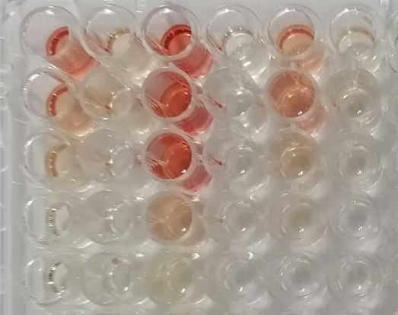
Biological Activity-Cytotoxicity Activity
Hemolytic Assay:
S1
Figure 10. R represents the 96-well plate
Figure 11 Hemolytic assay of snail mucus.

Slide 12
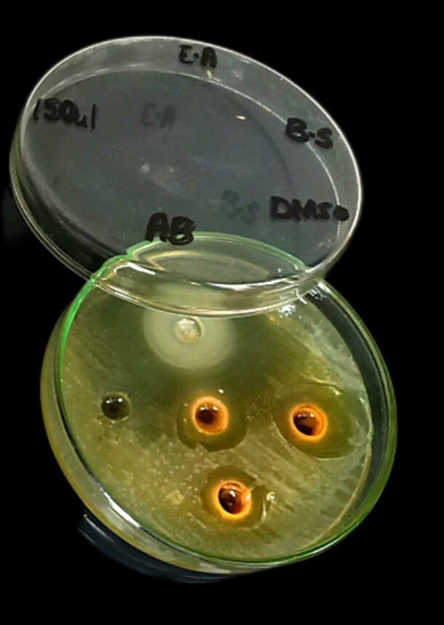
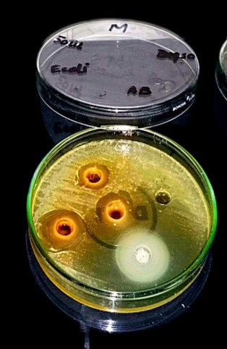

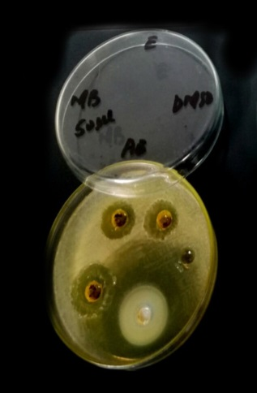
Biological Activity-Antimicrobial activity
Anti bacterial:
Positive control
Negative control
Snail mucus 1
Snail mucus 2
Snail mucus 3
Figure 12 represents antibacterial activity against subtilis col, P. aruginosa
Figure 13 represents the agar plate

Slide 13
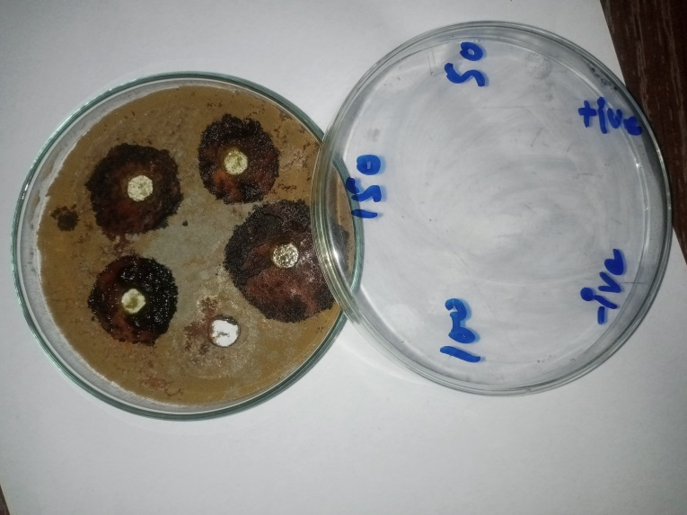
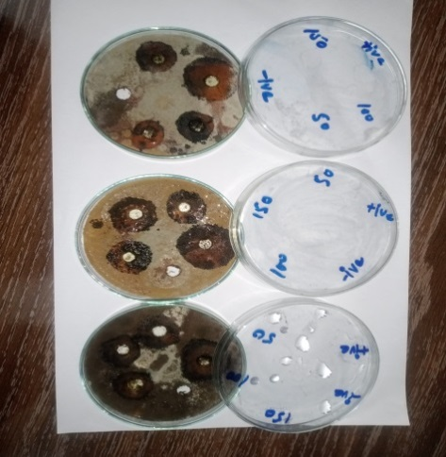
Biological Activity-Cytotoxicity Activity
Anti fungal:
Figure 14 represents anti-fungal activity against aspergillus riger, and Fusarium oxysporum
Figure 15 represents the SDA plate

Slide 14
Conclusion
The present study Research that snail mucus extracts exhibit significant antioxidant, cytotoxic, antimicrobial activities, and anti fungal, highlighting their potential as a natural bioactive agent.
Chemical analysis revealed the presence of key compounds that may contribute to these biological effects.
Overall, these findings support the therapeutic and cosmetic potential of snail mucus, providing a strong foundation for further pharmacological and industrial applications.
Future studies should focus on mechanistic insights, in vivo validation, and formulation development to fully harness its bioactive properties

